Slide 1


AI at the helm of a species evolution Dr Sana Zakaria, Research Leader RAND Europe

Slide 2
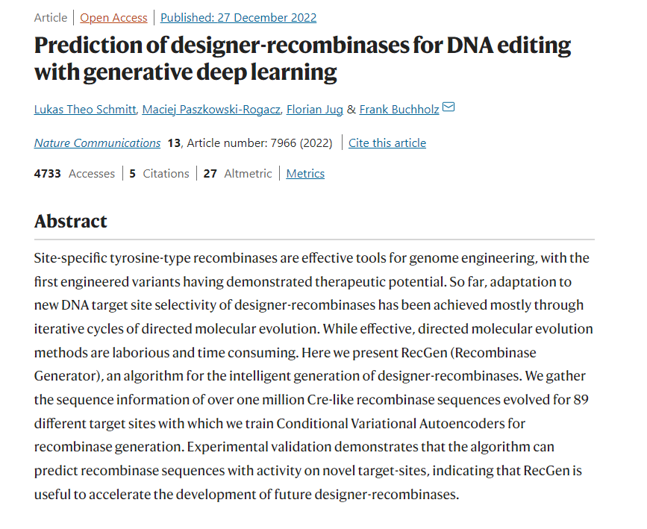
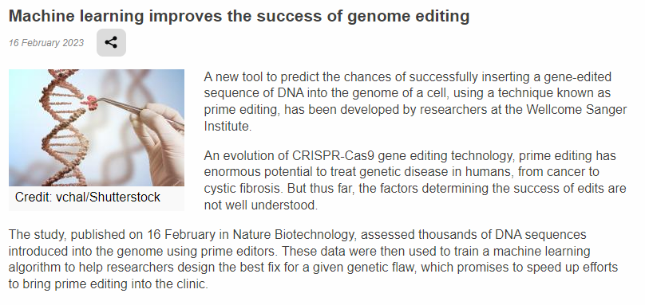
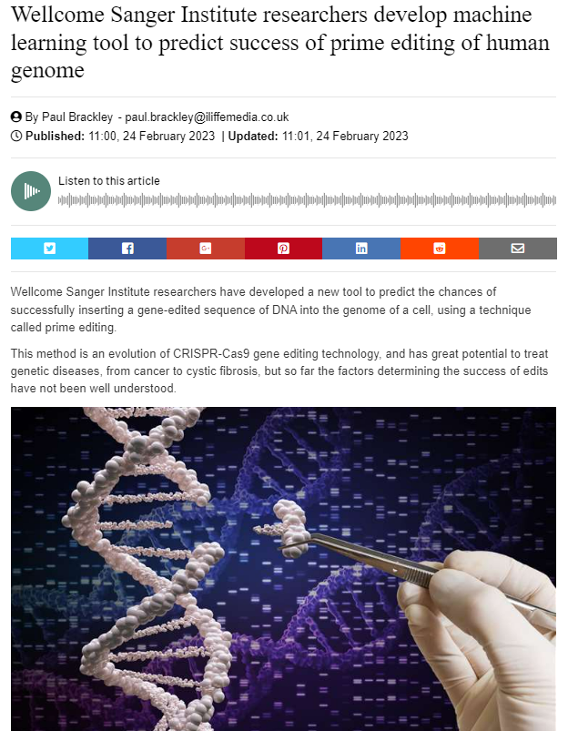
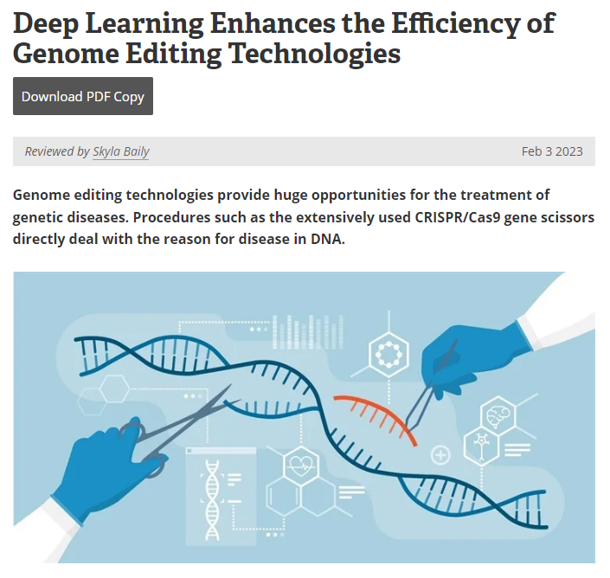
Notes:
Advanced in AI-more specifically ML has catalysed various sectors. Our focus is on how it is being applied to a highly regulated and at times controversial technology of gene editing. These technologies are being increasingly brought together and their combined potential has been recognised as evident in these papers and news article headlines.

Slide 3


Tech synergy can yield both threats and opportunities
Risks
Benefits
?
Notes:
Technology across sectors is coming together with new applications unlocking new possibilities however this melding of technologies brings both risks and benefits- Rate of technological advancement is outpacing society's ability to deliberate policy implications

Slide 4
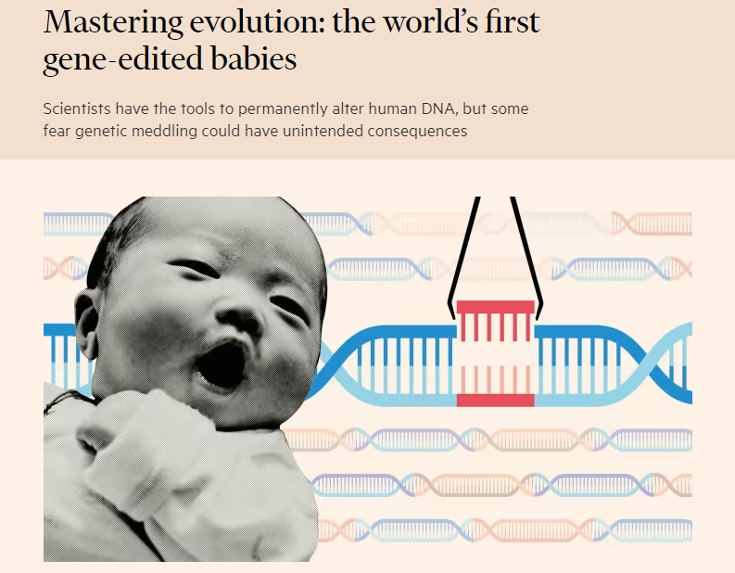
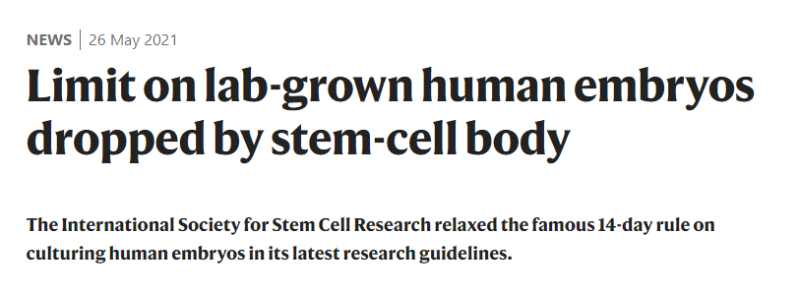
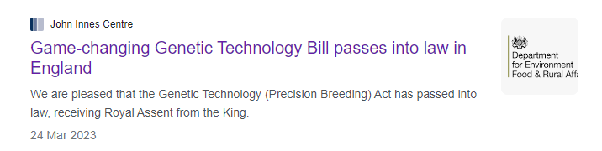
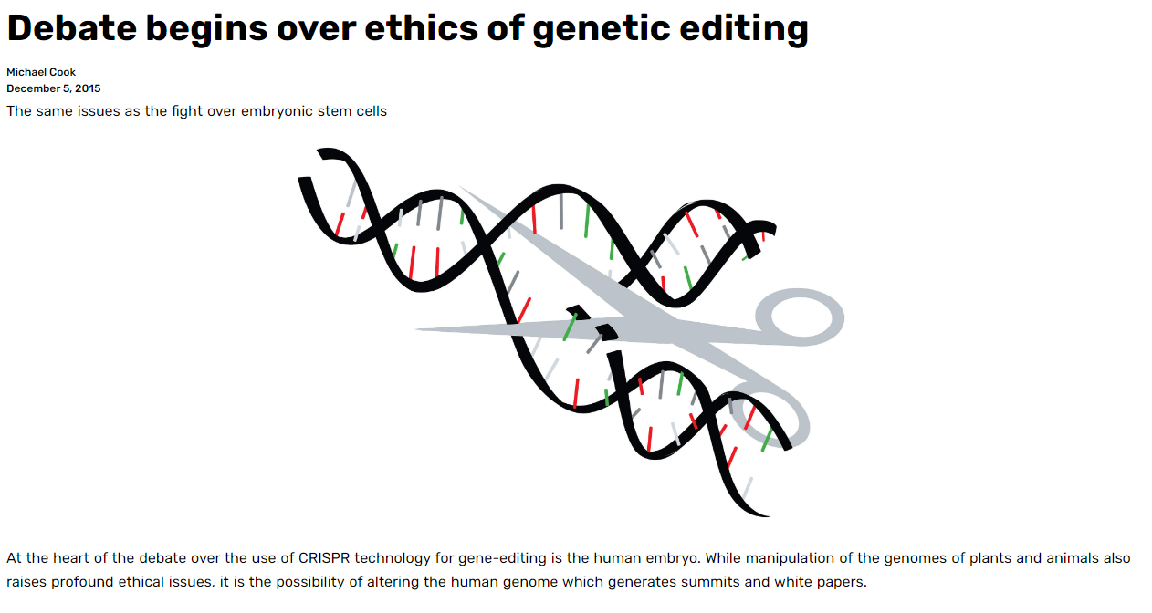
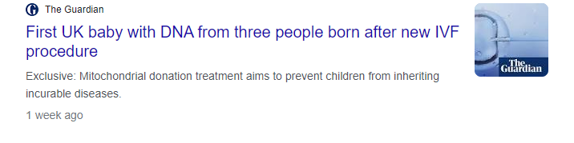
Permissiveness and pushing boundaries
Notes:
History is littered with examples of technology being used to push boundaries, in the case of gene editing we don’t really have to go far to see things changing…there was academic and public outcry and backlash when the first gene edited babies were born in China, but that didn’t halt continued debate on the ethics of gene editing, by communities and others who have championed stem cell research to get to where it is today. Then we saw rules on lab grown embryos being relaxed, UK based its genetic technology bill into law and we are seeing three parent babies being born as a result of genetic manipulation of mitochondrial DNA. These are things we would never have imaged 10 or 15 years ago.

Slide 5
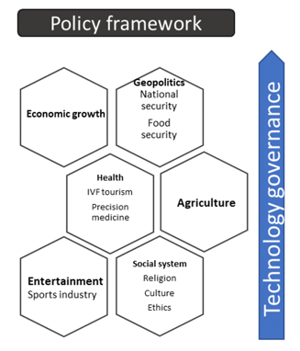
Pro-active policy guidance could ensure optimal use
Risks
Benefits
Notes:
So it is really important to note that as technology progresses, so does our ability to predict, anticipate and prepare. From a technology governance perspective, any pro-active policy would need to assess im[act of technologies on multiple sectors from agriculture, entertainment, health to social acceptability and create something that works to minmise risks and increase benefits.

Slide 6
Research aims
Review: take stock of advances in ML-facilitated genome editing and policy trends
Project: develop a future scenario-focussed framework to protect human interest by considering the implications of these technologies being pursued at scale and globally
Consider policy: investigate the policy implications of the application of ML to genome editing in humans
Scope: confluence of ML and gene editing, looking across EU, US, China
Notes:
Our geographic scope in particular is limited to regions with large scale investments in AI and biotechnology and their convergence and where political and institutional agendas that are relevant to both technologies.
This is a proof of principle study which is limited in scope and is ongoing….to be concluded in Sept

Slide 7
Analytical approaches
Landscape assessment
Futures methodology
Multifactor scenarios development
Key risks, benefits and policy considerations across the range of scenarios
Table top stakeholder exercise
Desk research
Stakeholder interviews
Horizon scanning
Typology
Notes:
Desk research to look at how key advancements and key policies have emerged over time across multiple geographies of interest. We did this separately for GE and ML leading to state of the art tech in GE, ML and at their interface
Supplemented by subject matter interviews on disruptive tech and challenges to consider
Created a typology of policy styles and key impacts and barriers of tech
Moving into futures to create scenarios into 2045 and discuss policy needs across the range of scenarios

Slide 8
Policy styles: an analytical framework
Pre-emptive: Provides highly restrictive or prohibitive regulations that seek to prevent perceived potential impacts even if those impacts have yet to realise
Proactive: Considers potential negative and positive impacts as a result of discourse between policymakers and scientists
Reactionary: Formulates regulation and policymaking as a response to a innovation that has caused controversy or much media attention
Legacy: Relies on a priori existing regulations or guidelines from other domains and apply those to gene editing technologies
Notes:
We conducted an assessment of policies over time (last few decades) looking at milestone policies that have taken place and their relationship to technological advancement. This was done for ML and Gene editing separately to see how the tech has been governed over time, across different geographies. We found 4 main predominant styles of policymaking which are not mutually exclusive.

Slide 9
Policies and styles in gene editing
Policymaking styles in gene editing have primarily been pre-emptive and/or reactionary
Attitudes to permissiveness versus risk aversion in policymaking dependent on application of the tech to human health, gene drives technology, or agriculture

Slide 10
Policies and styles in AI
Policymaking styles in AI/ML have primarily been reactionary and/or legacy based.
In the case of AI, reactionary policymaking has spurred innovation.
International brokers have played a key role: significance in setting ethical principles and guiding principles in a national vacuum.
China’s proactive approach (through national action plans) is an exception to the rule has spurred competition and more proactive approached internationally
Notes:
Reactionary measures were brought in to cut down on funding and limit focus on AI due to its pverpromsie and underdelivery in the 70s and 80s….this spurred innovation and brought make more investment …

Slide 11
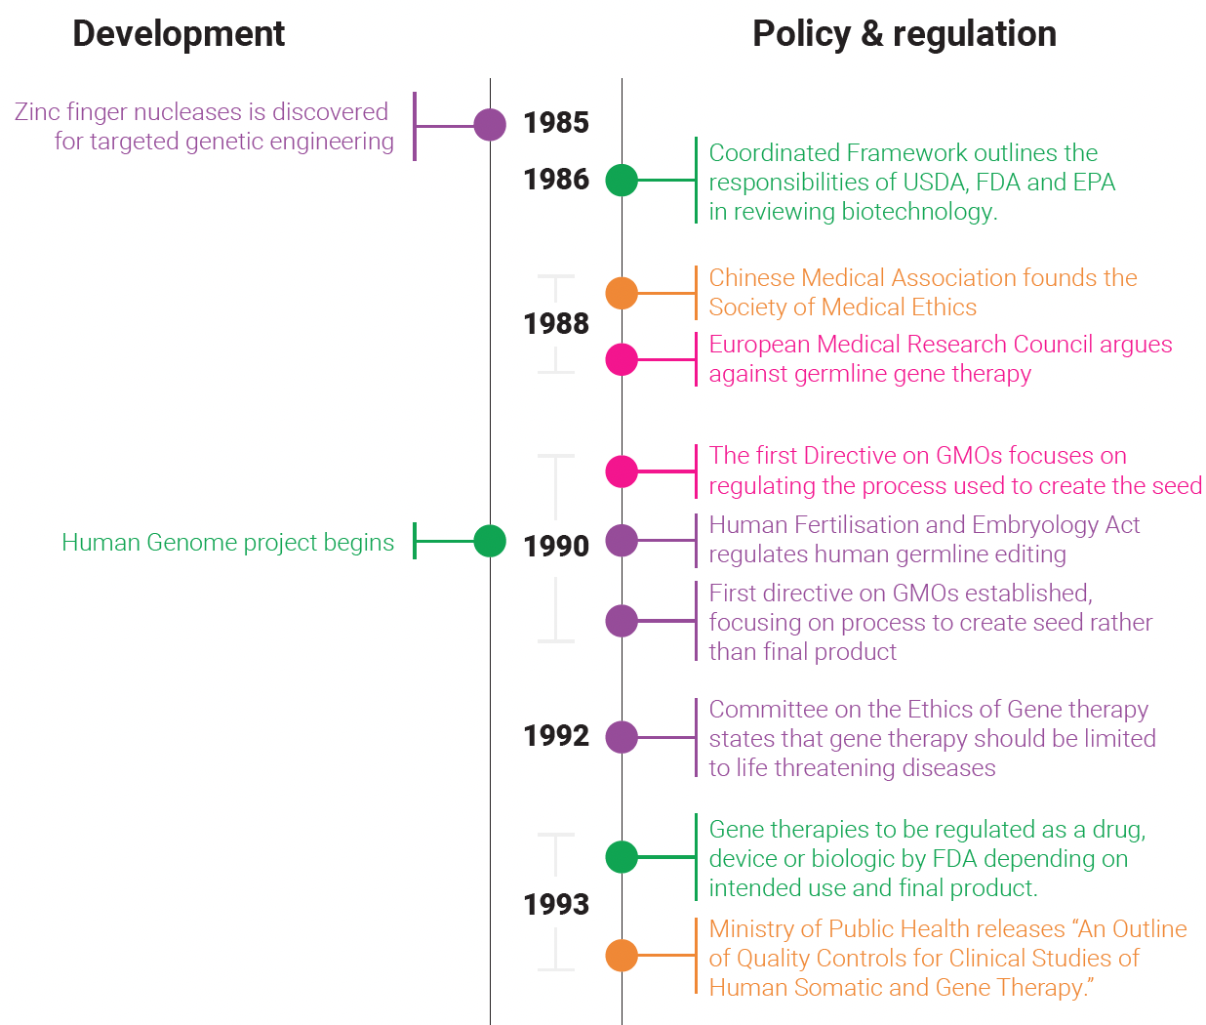

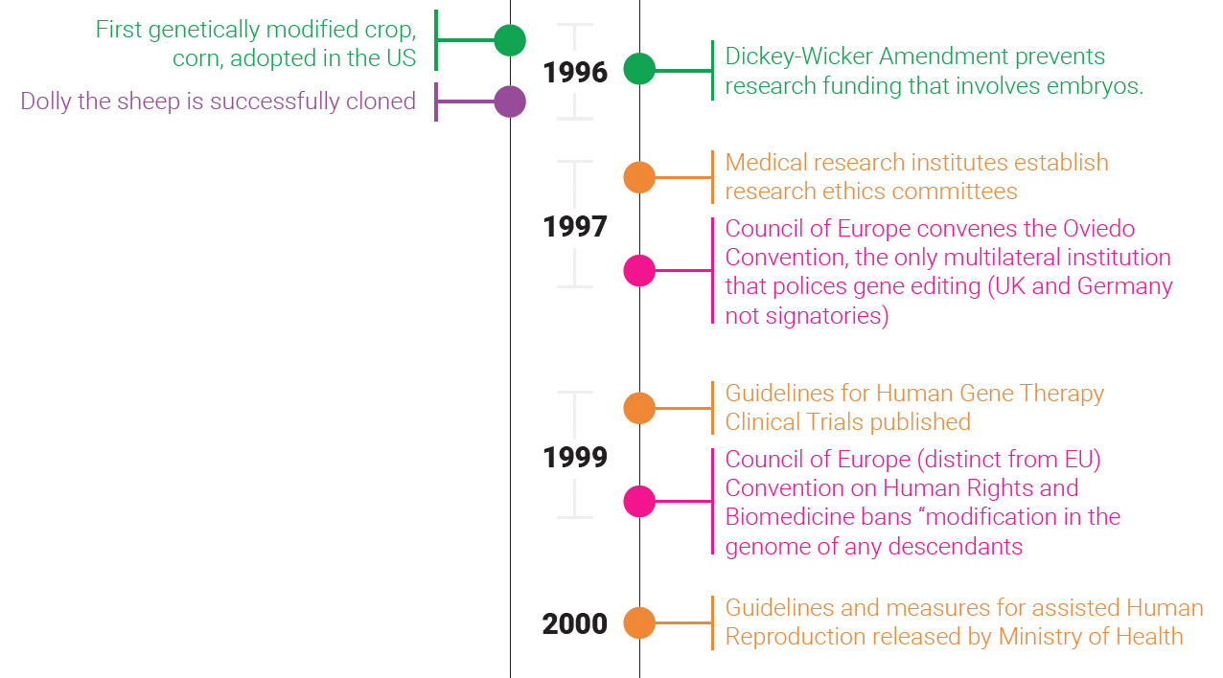

Mapping policy to technology (Gene editing)
Notes:
Example snapshot of our policy and tech development timeline in gene editing across geographies…a lot to unpack there!

Slide 12


State of the art technology
Precision gene editing
Large language models
Protein structure modelling
GWAS
General purpose AI
Precision genome engineering
Predictive genome-phenome associations
‘omics’ libraries
synthetic datasets
Mechanistic modelling
Novel algorithms
synthetic DNA
Notes:
What is it enabling?
Generation of new microbes
Generation of new capabilities like production of ethanol
New diagnostics
New therapeutics
Ability to create enhanced bioweapons
Ability to create food that can withstand extreme temperatures
This is happening at a pace and scale that is unparalleled without the use of ML

Slide 13
Barriers at the intersection of AI and biotech
Early-stage development
In silico (experimentation performed by a computer) vs real world testing
Blackbox in ML predictions
Standardization of data
Availability
Quality
Information is fragmented, siloed, and incomplete
Computational barriers
Skills force / lack of skilled personnel

Slide 14
Policy consideration at the interface of ML and GE
Very limited work or pro-active policymaking at the intersection of these technologies and their applications
Much of the tech is conceptual or lab based and hence the policy is lagging behind the technology
Future focussed scenarios of applications can pave the way for pro-active considerations in this space
Use of AI as a medical device or AI assisted surgery provides an interesting case study of the challenges in governing multi-purpose and varied technologies; such as developing rules on negligence and accountability, use of locked algorithms, etc.

Slide 15
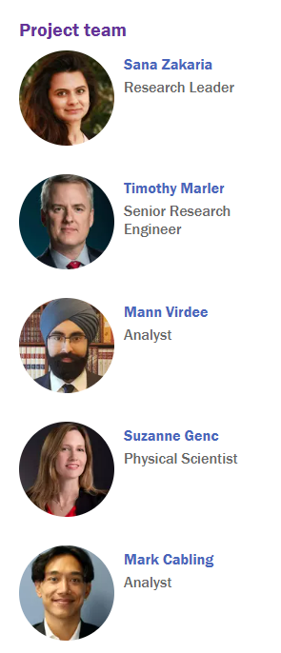
Thank you
Notes:
Moving into next phase with the team looking at future scenarios and policy considerations and reccs. You can find details on RAND Europe’s website and would love to hear from you/collaborate in this space.

